Slide 1
Principles of Distributed Database Systems
M. Tamer Özsu
Patrick Valduriez

Slide 2
Outline
Introduction
Distributed and Parallel Database Design
Distributed Data Control
Distributed Query Processing
Distributed Transaction Processing
Data Replication
Database Integration – Multidatabase Systems
Parallel Database Systems
Peer-to-Peer Data Management
Big Data Processing
NoSQL, NewSQL and Polystores
Web Data Management

Slide 3
Outline
Web Data Management
Web Models
Web Search
Web Querying
Hidden Web
Web Data Integration

Slide 4
Web Overview
Two segments
Publicly indexable web (PIW)
Deep web (hidden web)
Most Internet users gain access to the web using search engines
Keyword search
Question-Answer (QA) systems
Separate communities with little commonality

Slide 5
Outline
Web Data Management
Web Models
Web Search
Web Querying
Hidden Web
Web Data Integration

Slide 6
Web Model
Web graph
Pages are vertices
Hyperlinks between pages are edges
Semi-structured data
Properties
Volatile
Sparse
Self-organizing
“Small-world” graph
Power law graph

Slide 7
Structure of the Web

Slide 8
Outline
Web Data Management
Web Models
Web Search
Web Querying
Hidden Web
Web Data Integration

Slide 9
Search Engine Architecture

Slide 10
Web Crawling
What is a crawler?
Crawlers cannot crawl the whole Web. It should try to visit the “most important” pages first.
Importance metrics:
Measure the importance of a Web page
Ranking
Static
Dynamic
Ordering metric
How to choose the next page to crawl

Slide 11
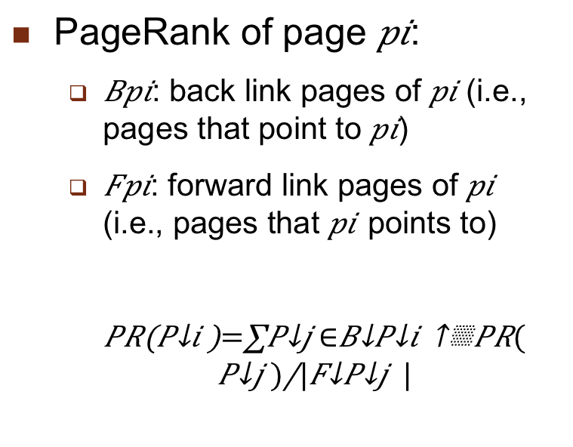
Static Ranking – Recall PageRank
Quality of a page determined by the number of incoming links and the importance of the pages of those links
PageRank of page $pi$:
$Bpi$: back link pages of $pi$ (i.e., pages that point to $pi$)
$Fpi$: forward link pages of $pi$ (i.e., pages that $pi$ points to)
$$PR\left(P_{i}\right)=\sum_{P_{j}∈B_{P_{i}}}{\frac{PR(P_{j})}{|F_{P_{j}}|}}$$

Slide 12
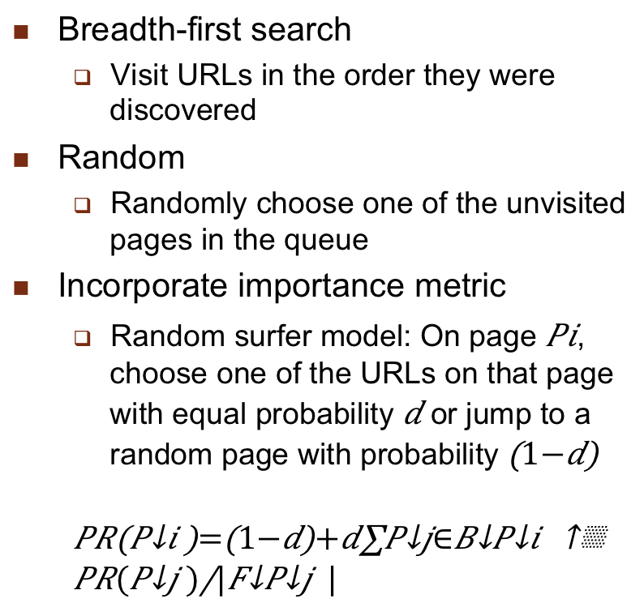
Ordering Metrics
Breadth-first search
Visit URLs in the order they were discovered
Random
Randomly choose one of the unvisited pages in the queue
Incorporate importance metric
Random surfer model: On page $Pi$, choose one of the URLs on that page with equal probability $d$ or jump to a random page with probability $\left(1−d\right)$
$$PR\left(P_{i}\right)=\left(1−d\right)+d\sum_{P_{j∈B_{P_{i}}}}{\frac{PR(P_{j})}{|F_{P_{j}}|}}$$

Slide 13
Web Crawler Types
Many Web pages change frequently, so the crawler has to revisit already crawled pages → incremental crawlers
Some search engines specialize in searching pages belonging to a particular topic → focused crawlers
Search engines use multiple crawlers sitting on different machines and running in parallel. It is important to coordinate these parallel crawlers to prevent overlapping → parallel crawlers

Slide 14
Indexing
Structure index
Link structure
Text index
Indexing the content
Suffix arrays, inverted index, signature files
Inverted index most common
Difficulties of inverted index
The huge size of the Web
The rapid change makes it hard to maintain
Storage vs. performance efficiency

Slide 15
Outline
Web Data Management
Web Models
Web Search
Web Querying
Hidden Web
Web Data Integration

Slide 16
Web Querying
Why Web Querying?
It is not always easy to express information requests using keywords.
Search engines do not make use of Web topology and document structure in queries.
Early Web Query Approaches
Structured (Similar to DBMSs): Data model + Query Language
Semi-structured: e.g. Object Exchange Model (OEM)

Slide 17
Web Querying
Question Answering (QA) Systems
Finding answers to natural language questions, e.g. What is Computer?
Analyze the question and try to guess what type of information that is required.
Not only locate relevant documents but also extract answers from them.

Slide 18
Approaches to Web Querying
Search engines and metasearchers
Keyword-based
Category-based
Semistructured data querying
Special Web query languages
Question-Answering

Slide 19
Semistructured Data Querying
Basic principle: Consider Web as a collection of semistructured data and use those techniques
Uses an edge-labeled graph model of data
Example systems & languages:
Lore/Lorel
UnQL
StruQL

Slide 20
OEM Model

Slide 21
Lorel Example
Find the authors of all books whose price is under $100
SELECT D(.authors)?.author
FROM bib.doc D
WHERE D.what = “Books” AND D.price < 100
Find the titles of documents written by Patrick Valduriez
SELECT D.title
Notes:
Note: slide is animated

Slide 22
Evaluation
Advantages
Simple and flexible
Fits the natural link structure of Web pages
Disadvantages
Data model too simple (no record construct or ordered lists)
Graph can become very complicated
Aggregation and typing combined
DataGuides
No differentiation between connection between documents and subpart relationships

Slide 23
DataGuide – Graph Summary

Slide 24
Web Query Languages
Basic principle: Take into account the documents’ content and internal structure as well as external links
The graph structures are more complex
First generation
Model the web as interconnected collection of atomic objects
WebSQL
W3QL
WebLog
Second generation
Model the web as a linked collection of structured objects
WebOQL
StruQL

Slide 25
WebSQL Examples
DOCUMENT(URL,TITLE,TEXT,TYPE,LENGTH,MODIF)
LINK(BASE,HREF,LABEL)
Simple search for all documents about “hypertext”
SELECT D.URL, D.TITLE
FROM DOCUMENT D
SUCH THAT D MENTIONS “hypertext”
WHERE D.TYPE = “text/html”
Find all links to applets from documents about “Java”
SELECT A.LABEL, A.HREF
FROM DOCUMENT D
SUCH THAT D MENTIONS “Java”
ANCHOR A
SUCH THAT BASE = X
WHERE A.LABEL = “applet”
Demonstrates two scoping methods and a search for links.

Slide 26
WebSQL Examples (cont’d)
DOCUMENT(URL,TITLE,TEXT,TYPE,LENGTH,MODIF)
LINK(BASE,HREF,LABEL)
Find documents that have string “database” in their title that are reachable from the ACM Digital Library home page through paths of length ≤ 2 containing only local links.
SELECT D.URL, D.TITLE
FROM DOCUMENT D
SUCH THAT ”http://www.acm.org/dl”=|->|->-> D
WHERE D.TITLE CONTAINS “database”
Demonstrates the use of different link types.

Slide 27
WebSQL Examples (cont’d)
DOCUMENT(URL,TITLE,TEXT,TYPE,LENGTH,MODIF)
LINK(BASE,HREF,LABEL)
Find documents mentioning “Computer Science” and all documents that are linked to them through paths of length ≤ 2 containing only local links
SELECT D1.URL, D1.TITLE, D2.URL, D2.TITLE
FROM DOCUMENT D1
SUCH THAT D1 MENTIONS “Computer Science”
DOCUMENT D2
SUCH THAT D1=|->|->-> D2
Demonstrates combination of content and structure specification in a query

Slide 28
WebOQL
Prime
Peek
Hang
Concatenate
Head
Tail
String pattern match (~)

Slide 29
WebOQL Examples
Find the titles and abstracts of all documents authored by “Ozsu”
SELECT [y.title, y’.URL]
FROM x IN dbDocuments, y in x’
WHERE y.authors ~ “Ozsu”

Slide 30
Evaluation
Advantages
More powerful data model - Hypertree
Ordered edge-labeled tree
Internal and external arcs
Language can exploit different arc types (structure of the Web pages can be accessed)
Languages can construct new complex structures.
Disadvantages
You still need to know the graph structure
Complexity issue

Slide 31
Question-Answer Approach
Basic principle: Web pages that could contain the answer to the user query are retrieved and the answer extracted from them.
NLP and information extraction techniques
Used within IR in a closed corpus; extensions to Web
Examples
QASM
Ask Jeeves
Mulder
WebQA

Slide 32
QA Systems
Analyze and classify the question, depending on the expected answer type.
Using IR techniques, retrieve documents which are expected to contain the answer to the question.
Analyze the retrieved documents and decide on the answer.

Slide 33
Question-Answer System

Slide 34
Outline
Web Data Management
Web Models
Web Search
Web Querying
Hidden Web
Web Data Integration

Slide 35
Searching The Hidden Web
Publicly indexable web (PIW) vs. hidden web
Why is Hidden Web important?
Size: huge amount of data
Data quality
Challenges:
Ordinary crawlers cannot be used.
The data in hidden databases can only be accessed through a search interface.
Usually, the underlying structure of the database is unknown.

Slide 36
Searching The Hidden Web
Crawling the Hidden Web
Submit queries to the search interface of the database
By analyzing the search interface, trying to fill in the fields for all possible values from a repository
By using agents that find search forms, learn to fill them, and retrieve the result pages
Analyze the returned result pages
Determine whether they contain results or not
Use templates to extract information

Slide 37
Searching The Hidden Web
Metasearching
Database selection – Query Translation – Result Merging
Database selection is based on Content Summaries.
Content Summary Extraction:
RS-Ord and RS-Lrd
Focused Probing with Database Categorization

Slide 38
Outline
Web Data Management
Web Models
Web Search
Web Querying
Hidden Web
Web Data Integration

Slide 39
Web Data Integration
“Big data” characteristics play a role
No or highly variable (among sources) schema
Numbers are much higher
Data quality is a major issue
“Pay-as-you-go” integration
Data spaces → data lakes
Some approaches
Web Tables/Fusion Tables
Semantic web & Linked Open Data (LOD)

Slide 40
Web Tables/Fusion Tables

Slide 41
Semantic Web
Vision: Move data from machine processable to machine understandable by integrating structured and unstructured web data and marking it up semantically
Components
Web data marked up so metadata is captured as annotations
Ontologies to make different data collections understandable
Logic-based technologies to access both metadata & ontologies

Slide 42
Linked Open Data (LOD)
LOD is a realization and clarification of this vision → linkages among data is an important part of the vision
Integrate data on the web based on four principles:
All web sources (data) are locally identified by their URIs that serve as names
These names are accessible by HTTP
Information about data sources/entities are encoded as RDF (Resource Description Framework)
Connections among datasets are established by data links

Slide 43
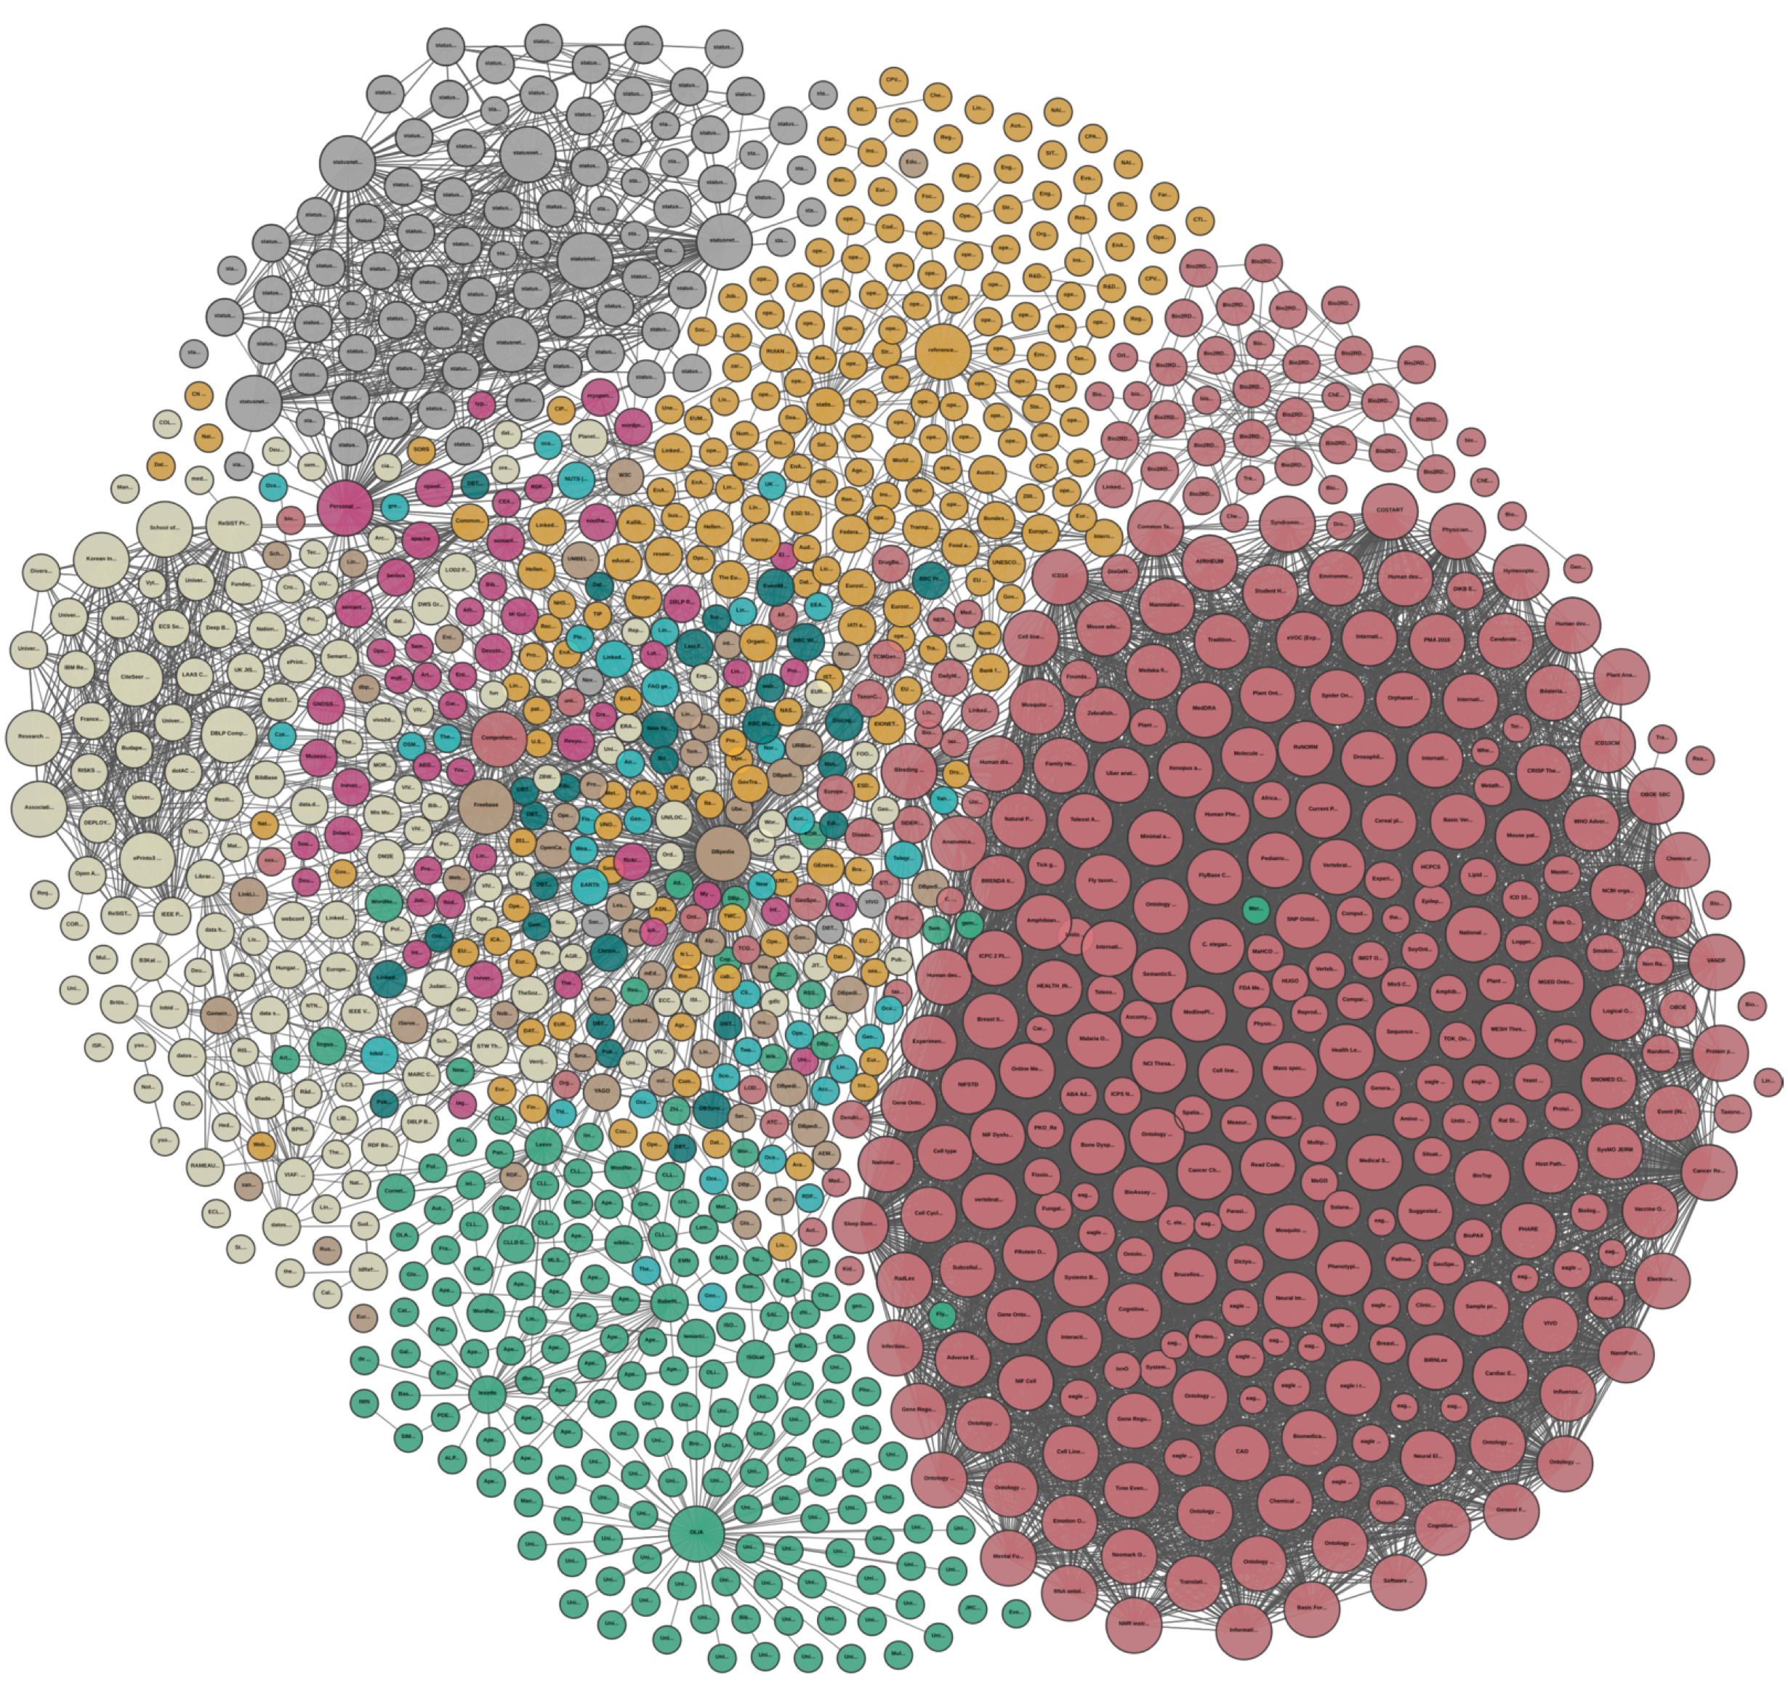
LOD Graph (as of 2018)

Slide 44
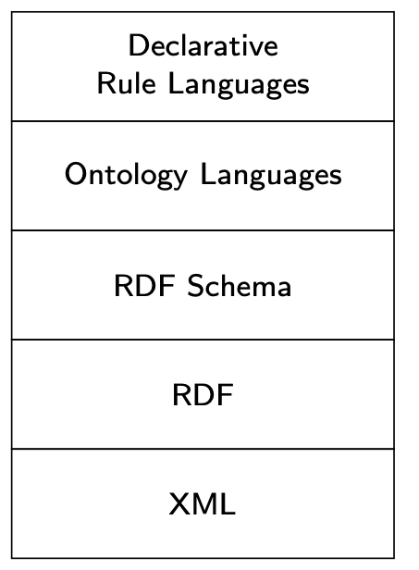
Semantic Web Technologies

Slide 45
XML Overview
Data is divided into pieces called elements
Elements can be nested, but not overlapped
Nesting represents hierarchical relationships between the elements
Elements have attributes
Elements can also have relationships to other elements (ID-IDREF)
Can be represented as a graph, but usually simplified as a tree
Root element
Zero or more child elements representing nested subelements
Document order over elements
Attributes are also shown as nodes

Slide 46
XML Schema
Can be represented by a Document Type Definition (DTD) or XMLSchema
Simpler definition using a schema graph: 5-tuple ⟨∑, Ψ, s, m, ρ⟩
∑ is an alphabet of XML document node types
Ψ ⊆ ∑ × ∑ is a set of edges between node types
e=(σ₁, σ₂) ∈ Ψ denotes item of type σ₁ may contain an item of type σ₂
s: Ψ → {ONCE, OPT, MULT}
ONCE: item of type σ₁ must contain exactly one item of type σ₂
OPT: item of type σ₁ may or may not contain an item of type σ₂
MULT: item of type σ₁ may contain multiple items of type σ₂
m: ∑ → {string}
m(σ) denotes the domain of text content of an item of type σ
ρ is the root node type

Slide 47
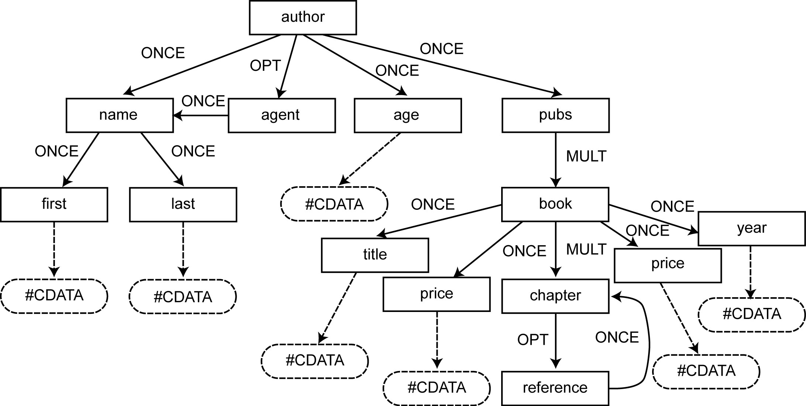
Example

Slide 48
XML Query Languages
child (/)
descendent
descendent-or-self (//)
parent
attribute (/@)
self (.)
ancestor
ancestor-or-self
following-sibling
following
preceding-sibling
preceding
namespace
Xpath
Based on path expressions
A list of steps
Each step consists of
An axis (13 of them)
A name test
Zero or more qualifiers
Last step is called a return step
Xquery
FLWOR expression
“for”, “let”, “where”, “order by”, “return” clauses
Each clause can reference path expressions or other FLWOR expressions
Similar to SQL select-from-where-aggregate but operating on a list of XML document tree nodes

Slide 49
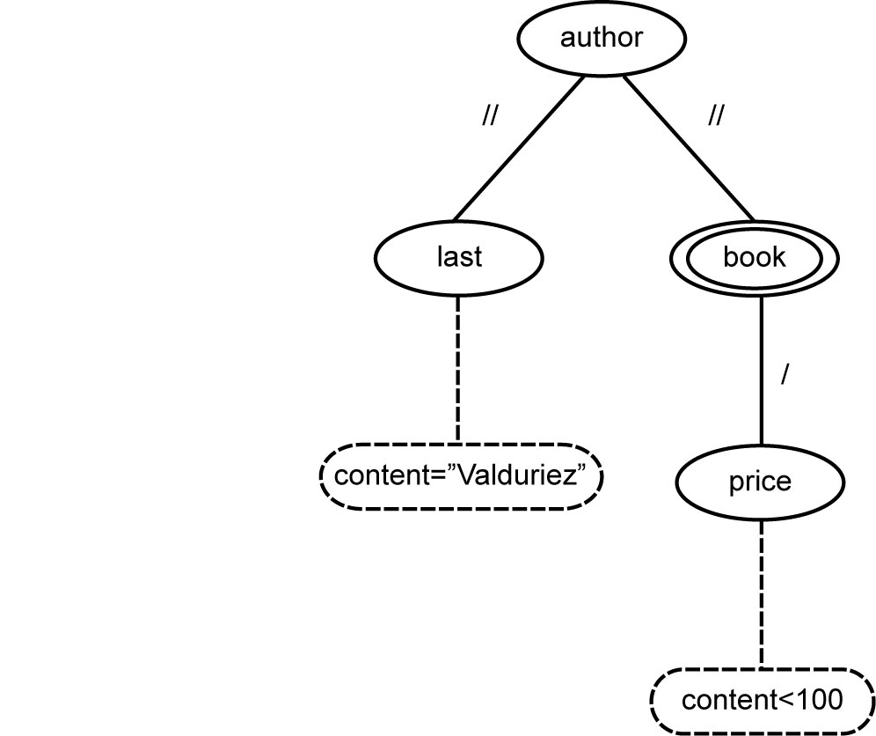
XPath Example
/author[.//last = “Valduriez”]//book[price < 100]
Name constraints
Correspond to name tests
Structural constraints
Correspond to axes
Value constraints
Correspond to value comparisons
Query pattern tree (QTP)

Slide 50
Xquery Example
Return a list of books with their title and price ordered by their attribute names
let $col := collection(“bib”)
for $author in $col/author
order by $author.name
for $b in $author/pubs/book
let $title := $b/title
let $price := $b/price
return $title, $price

Slide 51
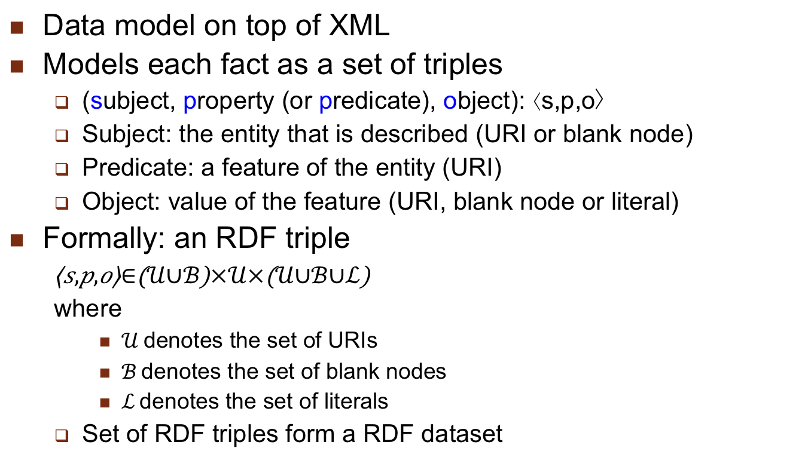
Resource Description Framework (RDF)
Data model on top of XML
Models each fact as a set of triples
(subject, property (or predicate), object): ⟨s,p,o〉
Subject: the entity that is described (URI or blank node)
Predicate: a feature of the entity (URI)
Object: value of the feature (URI, blank node or literal)
Formally: an RDF triple
$$\left\langle s,p,o\right\rangle ∈\left(𝒰∪ℬ\right)×𝒰×\left(𝒰∪ℬ∪ℒ\right)$$
where
$𝒰$denotes the set of URIs
$ℬ$denotes the set of blank nodes
$ℒ$denotes the set of literals
Set of RDF triples form a RDF dataset

Slide 52
RDF Dataset Example

Slide 53
RDF Schema (RDFS)
Annotation of RDF data with semantic metadata
Allows the definition of classes and class hierarchies
Enables reasoning over RDF data (entailment)
Built-in class definitions
rdfs:Class, rdfs:subClassOf, rdfs:label, …
Example
Movies rdf:type rdfs:Class.
ActionMovies rdfs:subClassOf Movies.
Dramas rdfs:subClassOf Movies.

Slide 54
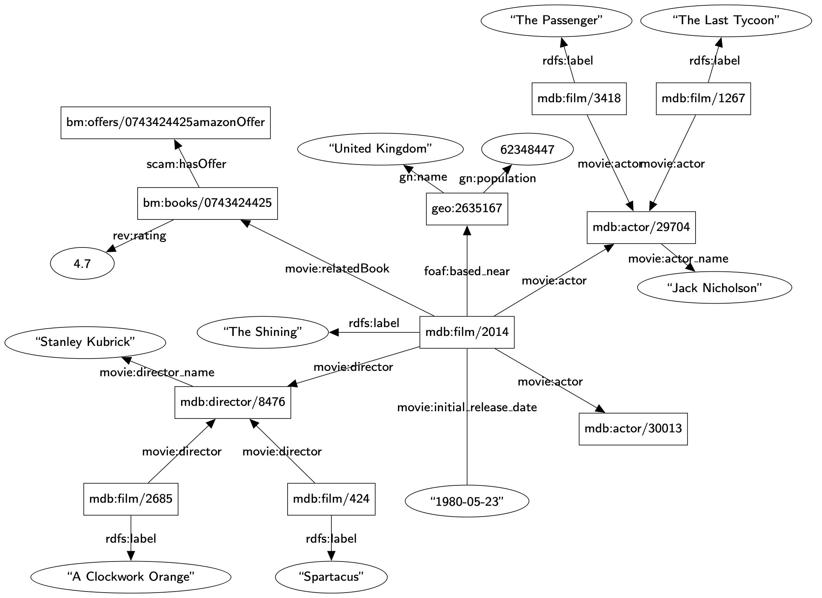
RDF Graph

Slide 55
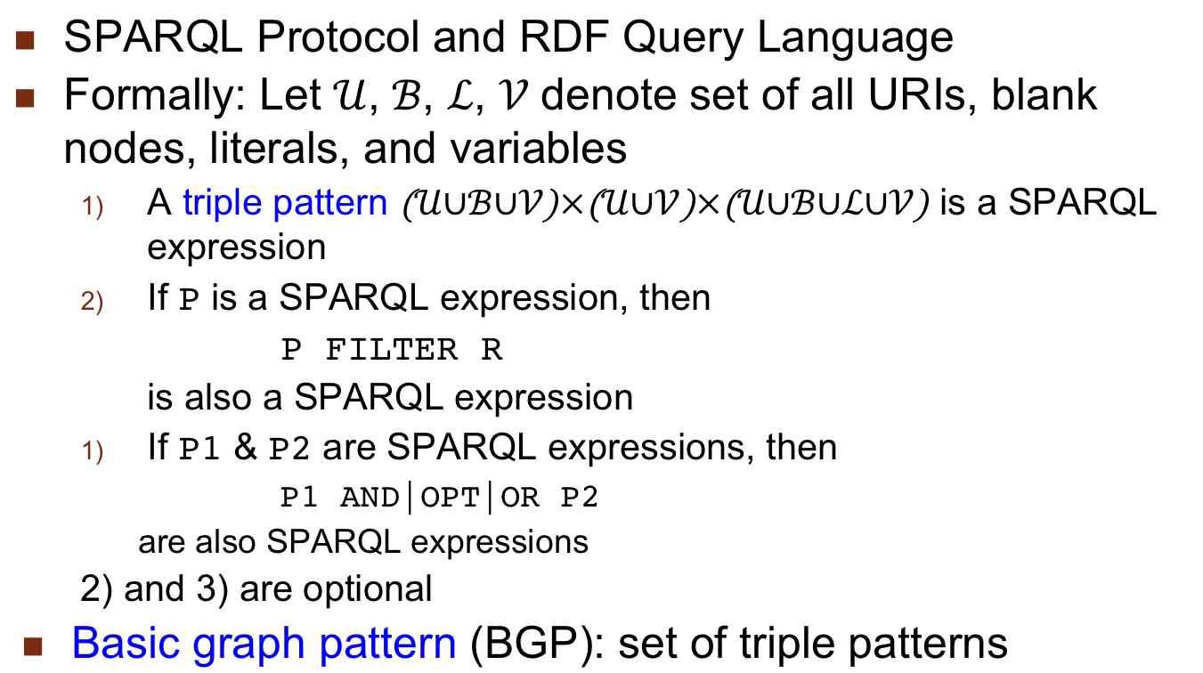
RDF Query Language – SPARQL
SPARQL Protocol and RDF Query Language
Formally: Let $𝒰$, $ℬ$, $ℒ$, $𝒱$ denote set of all URIs, blank nodes, literals, and variables
A triple pattern $\left(𝒰∪ℬ∪𝒱\right)×\left(𝒰∪𝒱\right)×\left(𝒰∪ℬ∪ℒ∪𝒱\right)$ is a SPARQL expression
If P is a SPARQL expression, then
P FILTER R
is also a SPARQL expression
If P1 & P2 are SPARQL expressions, then
P1 AND|OPT|OR P2
are also SPARQL expressions
2) and 3) are optional
Basic graph pattern (BGP): set of triple patterns

Slide 56
SPARQL Example
SELECT ?name
WHERE {
?m rdfs:label ?name. ?m movie:director ?d
?d movie:director_name “Stanley Kubrick”.
?m movie:relatedBook ?b. ?b rev:rating ?r.
FILTER(?r > 4.0)
}

Slide 57
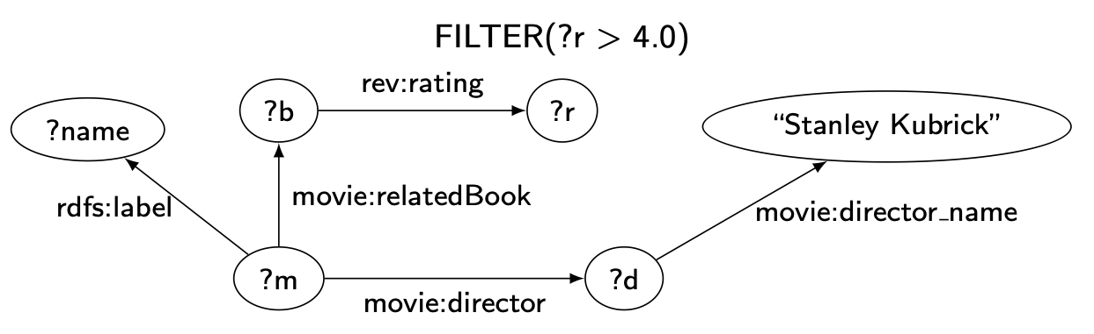
SPARQL Query Graph
SELECT ?name
WHERE {
?m rdfs:label ?name. ?m movie:director ?d
?d movie:director_name “Stanley Kubrick”.
?m movie:relatedBook ?b. ?b rev:rating ?r.
FILTER(?r > 4.0)
}

Slide 58
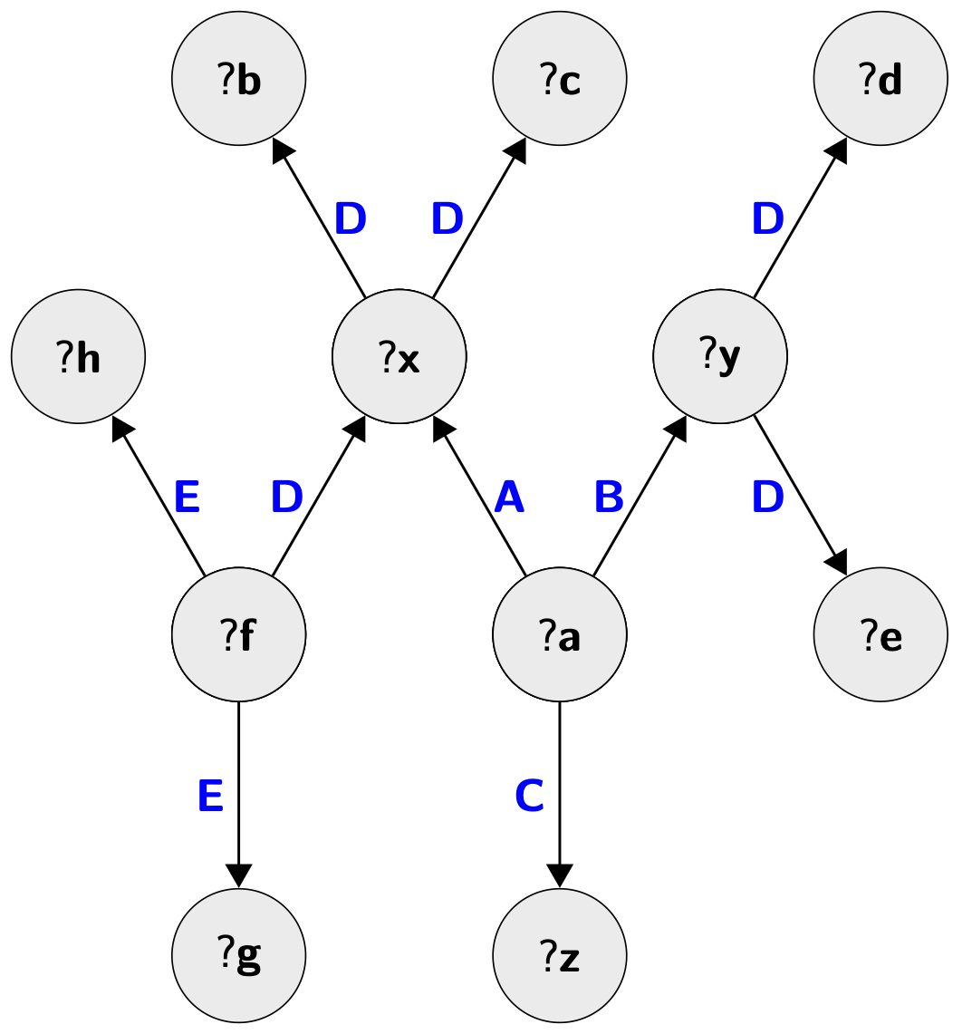
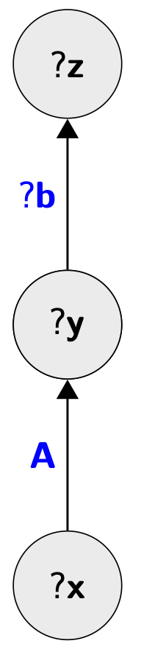
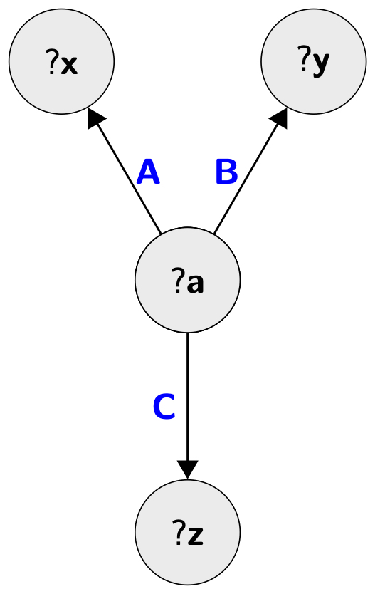
SPARQL Query Types
Linear
Star
Snowflake

Slide 59
RDF Data Management Approaches
Direct relational mapping
Relational schema with extensive indexing
Denormalize triples table into clustered properties
Column-store organization
Native graph representation

Slide 60
Direct Relational Mapping
SELECT ?name
WHERE {
?m rdfs:label ?name. ?m movie:director ?d
?d movie:director_name “Stanley Kubrick”.
?m movie:relatedBook ?b. ?b rev:rating ?r.
FILTER(?r > 4.0)
}
SELECT T1.object
FROM T AS T1, T AS T2, T AS T3,
T AS T4, T AS T5
WHERE T1.p=“rdfs:label”
AND T2.p=“movie:relatedBook”
AND T3.p=:movie:director”
AND T4.p=“rev:rating”
AND T5.p=“movie:director_name”
AND T1.s=T2.s
AND T1.s=T3.s
AND T2.o=T4.s
AND T3.o=T5.s
AND T4.o>4.0
AND T5.o=“Stanley Kubrick”
Too many
self-joins

Slide 61
Single Table Exhaustive Indexing
Maintain a single table of RDF triples
Create indexes for permutations of the three columns: SPO, SOP, PSO, POS, OPS, OSP
RDF-3X and Hexastore
Query processing
Each triple pattern can be evaluated by a range query
Joins between triple patterns computed using merge join
Join order is easy due to extensive indexing
Advantages
Eliminates some of the joins { they become range queries
Merge join is easy and fast
Disadvantages
Updates to indexes are expensive
Space usage

Slide 62
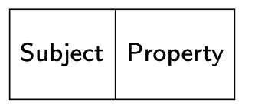
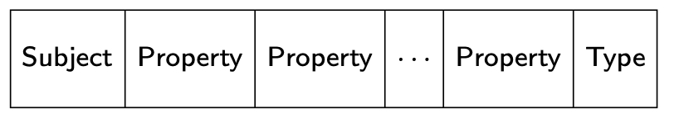
Property Tables
Grouping by entities
Jena
Clustered property table: group together the properties that tend to occur in the same (or similar) subjects
Property class table: cluster the subjects with the same type of property into one property table
Single-valued properties
Multi-valued properties

Slide 63
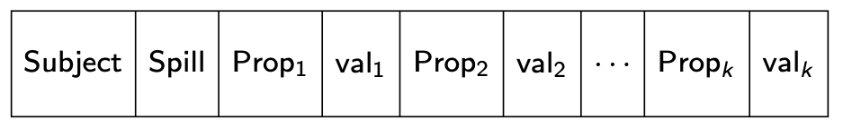
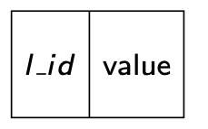
Property Tables (cont’d)
DB2-RDF same approach but different structure
Direct primary hash (DPH): organize by each subject with fixed number of (property, value) with spill
Properties in a given position might be different in different rows
Direct secondary hash (DSH): for multi-valued properties
DPH property value field has a pointer to DSH entry (l_id)

Slide 64
Property Tables Evaluation
Advantages
Star queries (subject-subject joins) become single table scans → fewer joins
Disadvantages
Can have significant number of null values
Dealing with multi-valued properties requires special care
Is not very helpful for non-star queries
Clustering “similar” properties is non-trivial

Slide 65
Binary Tables
Grouping by properties: For each property, build a two-column table, containing both subject and object, ordered by subjects
n two-column tables

Slide 66
Binary Tables Evaluation
Advantages
Advantages of column-oriented organization
Avoids null values
No need for (manual or automatic) clustering
Subject-subject joins by merge join
Disadvantages
Insertions are expensive
More joins are required
Other join types do not benefit

Slide 67
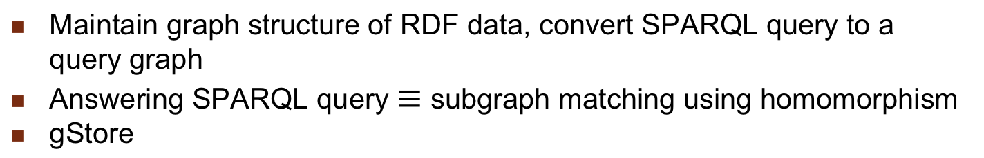
Graph-based Processing
Maintain graph structure of RDF data, convert SPARQL query to a query graph
Answering SPARQL query $≡$ subgraph matching using homomorphism
gStore

Slide 68
Graph-based Processing Evaluation
Advantages
Native representation → maintains the original graph structure
No restrictions on SPARQL queries
Disadvantage
Subgraph matching is expensive

Slide 69
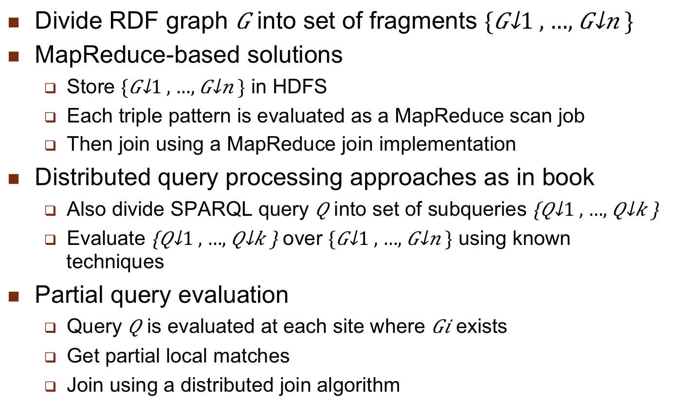
Distributed RDF Systems
Divide RDF graph $G$ into set of fragments $\{G_{1}, …, G_{n}\}$
MapReduce-based solutions
Store $\{G_{1}, …, G_{n}\}$ in HDFS
Each triple pattern is evaluated as a MapReduce scan job
Then join using a MapReduce join implementation
Distributed query processing approaches as in book
Also divide SPARQL query $Q$ into set of subqueries $\left\{Q_{1}, …, Q_{k}\right\}$
Evaluate $\left\{Q_{1}, …, Q_{k}\right\}$ over $\{G_{1}, …, G_{n}\}$ using known techniques
Partial query evaluation
Query $Q$ is evaluated at each site where $Gi$ exists
Get partial local matches
Join using a distributed join algorithm

Slide 70
Federated RDF Systems
Similar concerns to the relational counterparts
Similar approaches
Not all RDF data storage sites can execute SPARQL queries
SPARQL endpoints: storage sites that can execute queries
Precompute metadata at endpoints → specify the capabilities
Based on precomputation decompose a query and execute

Slide 71
Linked Open Data (LOD)
Consists of a set of web documents each with embedded RDF triples that encode web resources
Full web semantics: Scope of evaluating a SPARQL expression is all Linked Data
Query result completeness cannot be guaranteed by any (terminating) execution
Reachability-based semantics: Scope of a query is all data along paths of data links that satisfy the condition
Given a set of seed URIs & reachability condition, scope is all data along paths of data links reachable from the seeds & satisfying the reachability condition
Computationally feasible

Slide 72
SPARQL Over LOD
Traversal approach: Discover relevant URIs recursively by traversing (specic) data links at query execution runtime
Implements reachability-based query semantics
Index-based approach: Use an index to determine relevant URIs
Different index keys possible; e.g., triple patterns
Hybrid approach: Perform a traversal-based execution using a prioritized list of URIs to look up
Initial seed from the pre-populated index

Slide 73
Data Quality Issues
More serious in web data integration
Data from far more sources
Data sources are not as well controlled
Lack of schema information in web data
Might have to use data-based techniques and not schema-based
Data quality has two components
Data consistency
Veracity: authenticity and conformity of data with reality
Major challenge, but
High redundancy due to overlaps among data sources

Slide 74
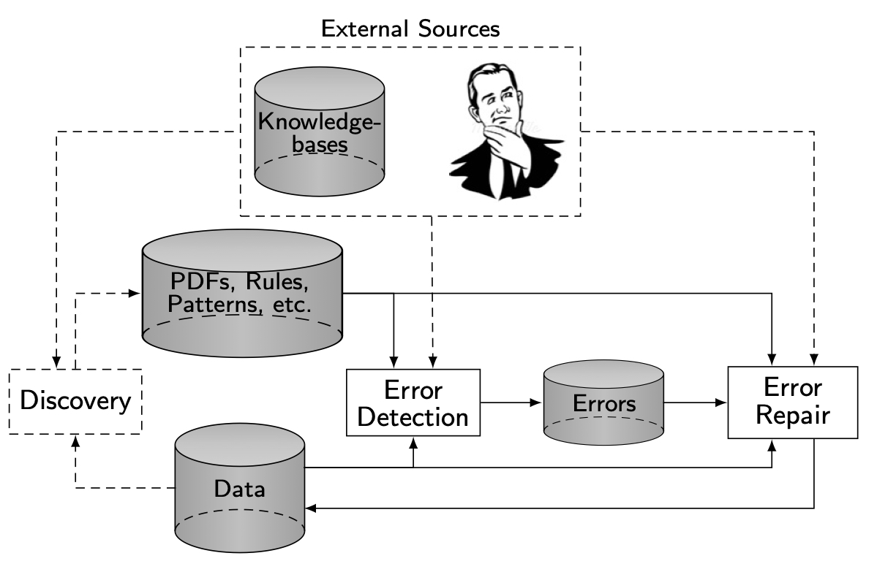
Cleaning Structured Web Data

Slide 75
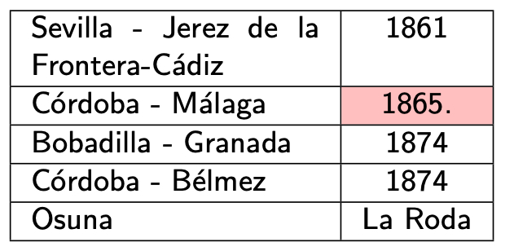
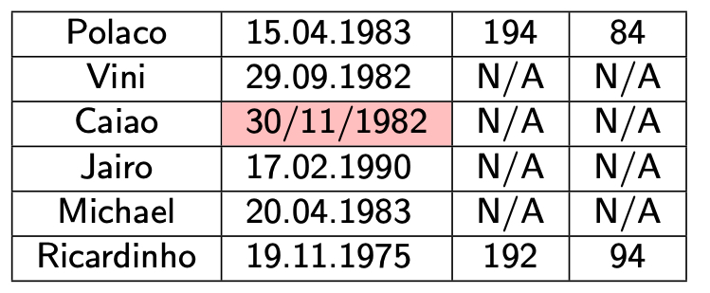
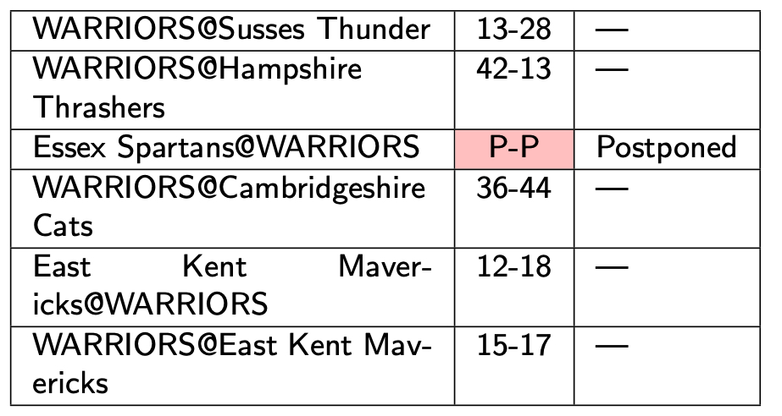
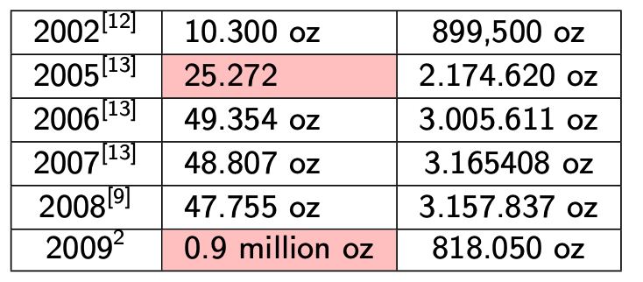
Cleaning Structured Web Data (cont’d)
Process works well when
Rich set of metadata exists
Enogh examples exist for automatic algorithms
May not be true in web tables

Slide 76
Web Data Fusion
Deciding the correct value for a data item that has differences among web sources
Conflicts:
Uncertainty: one source has a non-null value, others have null value
Due to missing information (hence null values)
Contradiction: two or more non-null values of the same data item do not agree
Typical enterprise data integration cleaning techniques may or may not work

Slide 77
Web Data Fusion Approaches

Slide 78
Web Source Quality
Not all sources are equal
Cleaning techniques cannot assume all values to be of the same accuracy
Web sources may copy from each other
Cannot ignore these dependencies
Values can evolve over time
Incorrect value and outdated value are not the same thing

